Slide 1
Voice Restoration Device Using Machine Learning of Acoustic and Visual Output During Electrolarynx Use
Sameer Agrawal, Surabhi Ghatti, Medhini Rachamallu, Katherine Taylor

Slide 2
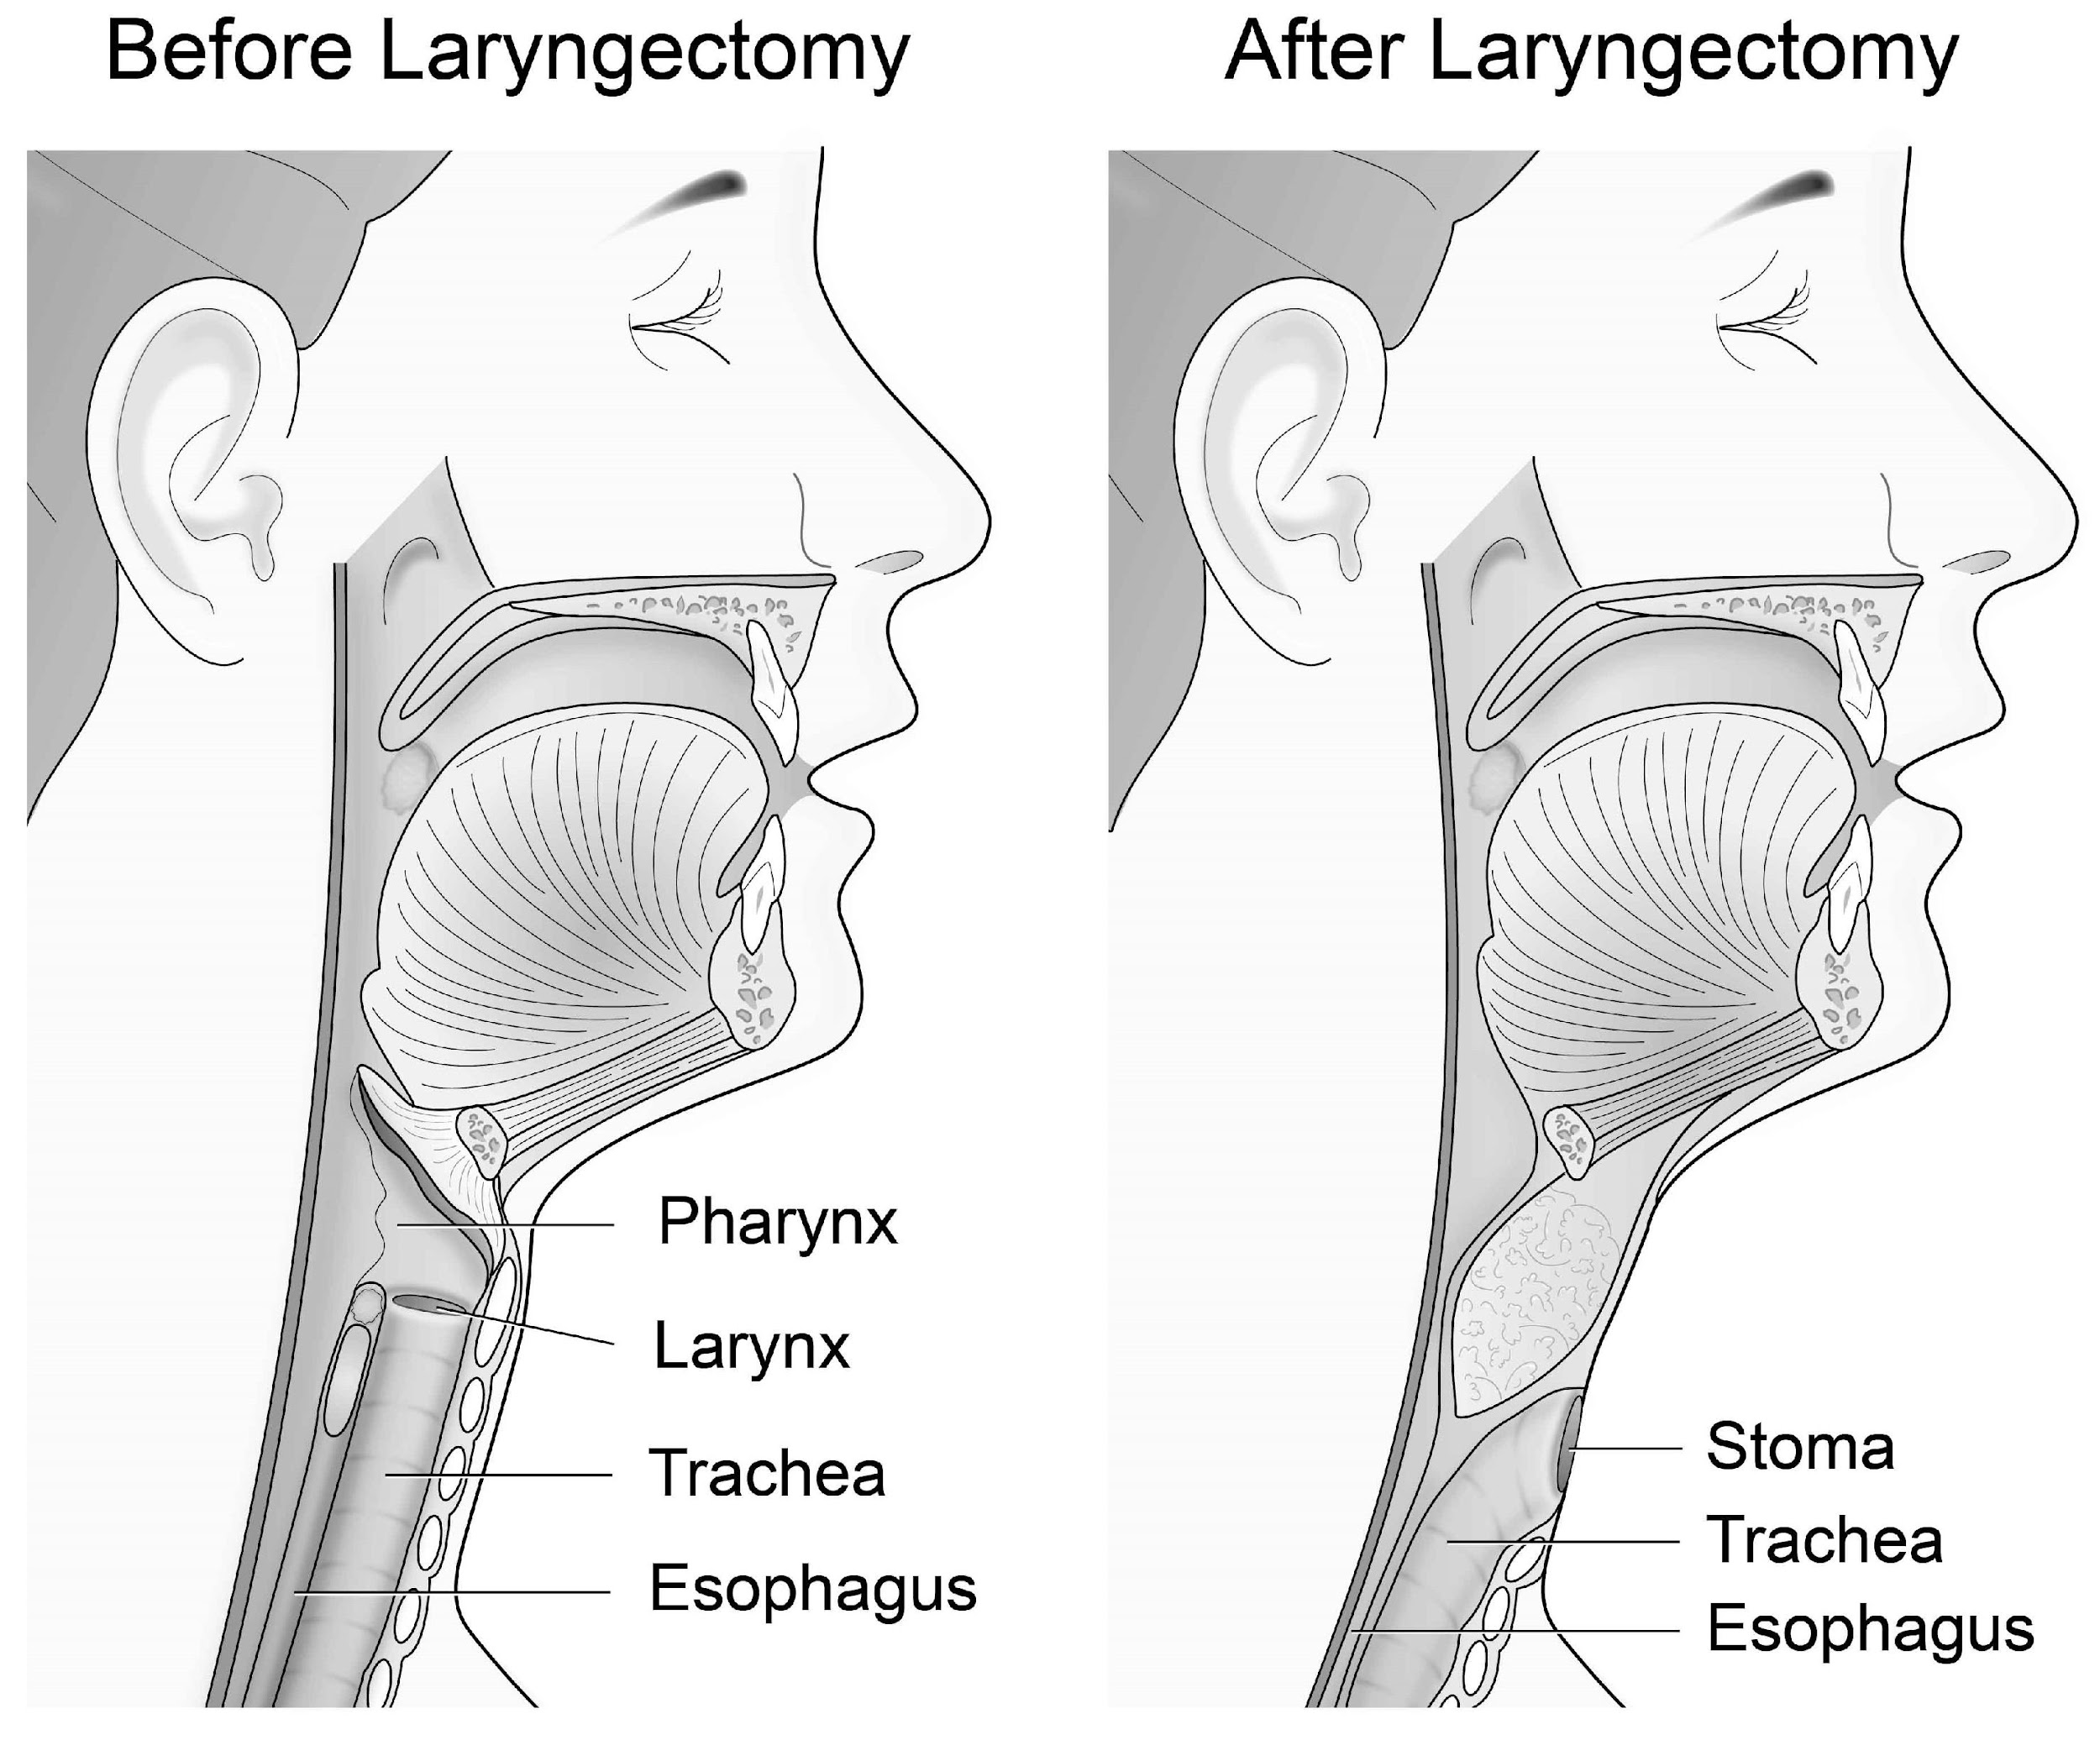
Introduction
Over 3000 people in the US every year undergo a laryngectomy¹⁻³
Laryngectomy complications:
Unintelligibility of speech¹
Reduced quality of life⁴⁻⁶
Prior research focuses on either video or audio data to predict speech¹
[4]
Notes:
Laryngectomy is total removal of the vocal cords – usually due to cancer
Many types of voice restoration therapies – electrolarynx is least invasive
Intention of our project is to create a new voice restoration therapy technique that uses a deep neural network to predict speech from both lip movements and audio output
Larynx plural = laryngees
Put box around what’s changing
Breathe in → lungs and breath out → lungs, vocal cord, tongue, mouth
But stoma → breathe doesn’t follow this path
Insurance covers cost → dont need
Other ways require operations
https://patient.uwhealth.org/healthfacts/7741

Slide 3
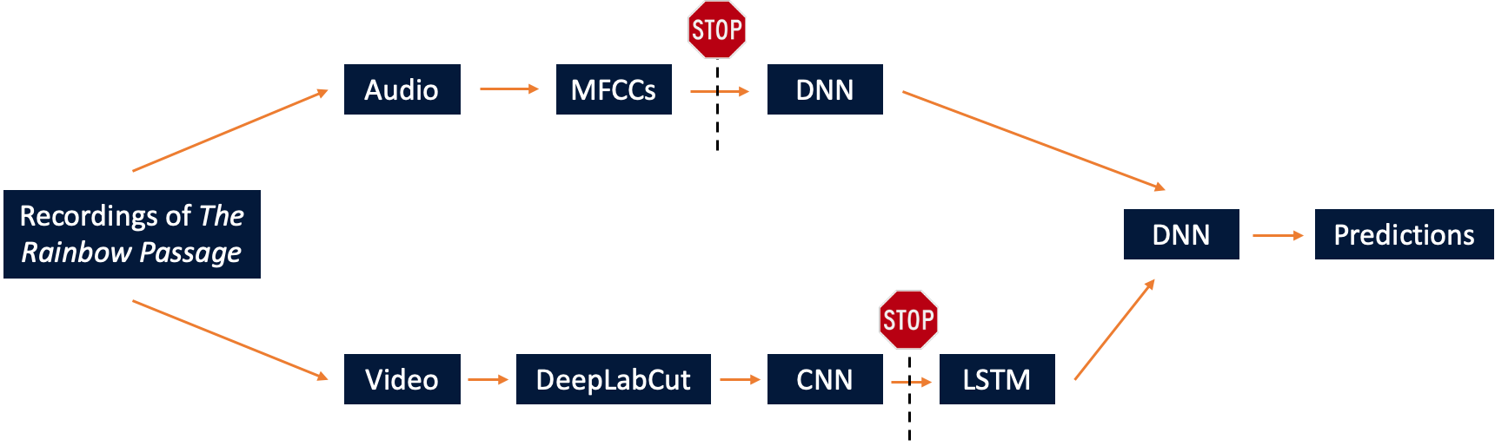
Pipeline
Separated into audio and video pipelines
Different types of neural networks for each pipeline
Combined at the end to predict speech
Notes:
Video pipeline: used a CNN to decrease dimensionality and an LSTM to predict words based on previous words
Audio pipeline: similar but had to extract MFCCs first
Combine using a basic DNN
Add in there was electro and normal into recor
Frame the stop signs in a positive manner

Slide 4
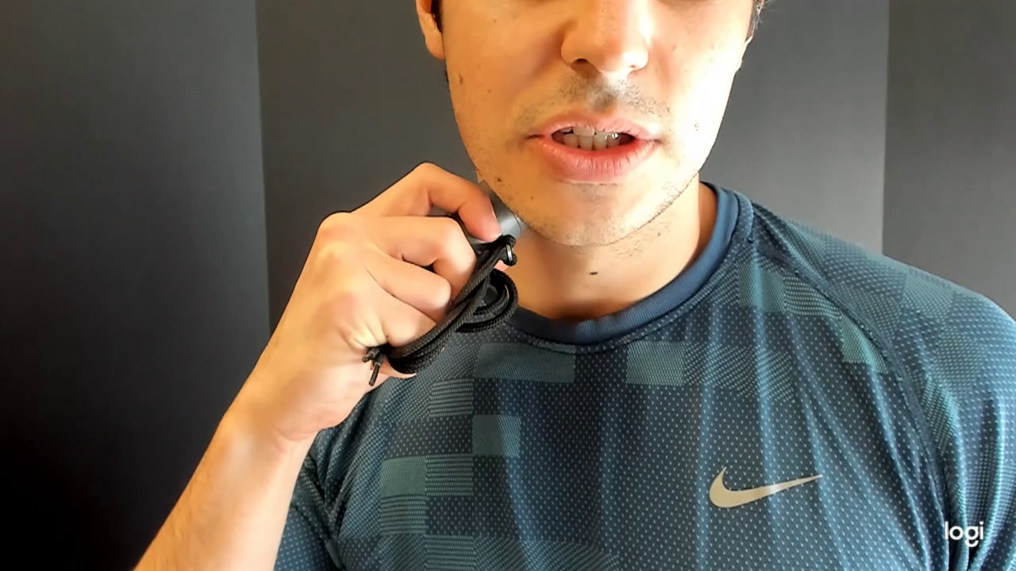
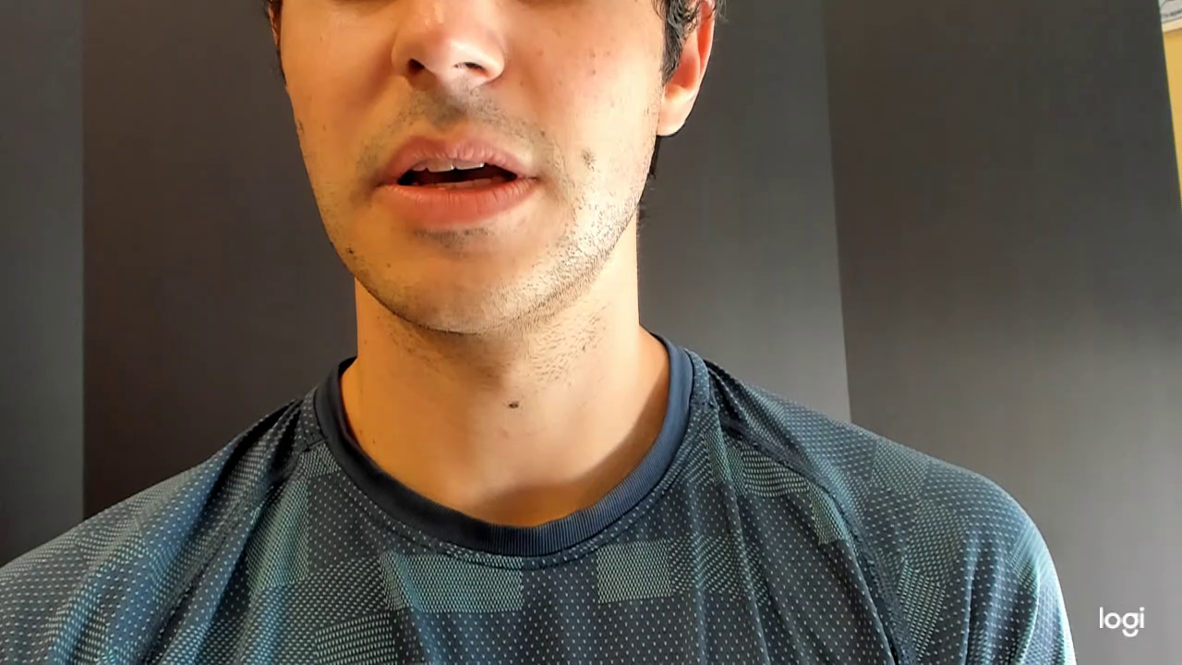
Materials and Methods: Data Collection
Five participants with functioning larynges recruited by advisors
Repeated the Rainbow Passage with and without an electrolarynx
Talked conversationally with and without an electrolarynx

Slide 5
AUDIO

Slide 6
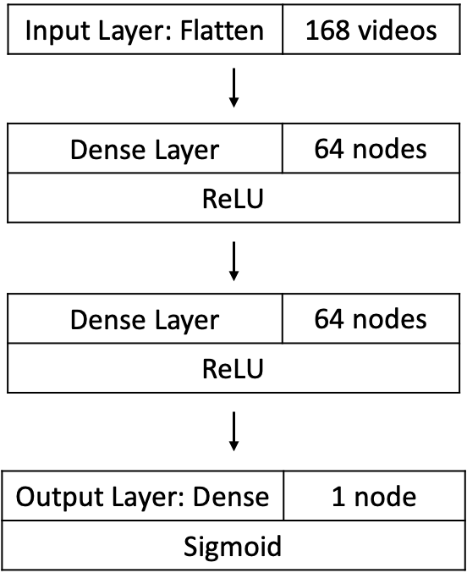
Materials and Methods: Audio Pipeline
Multiple Iterations with trial and error
Butterworth filter construction python scipy
MFCCs (Mel Frequency Cepstral Coefficients) with surfboard⁷
Binary classification (Normal vs Electrolarynx) with DNN with keras
Multi-label classification with Audacity clipped videos to put in a DNN with keras
Labels: When, the, sunlight, strikes, raindrops, in, air
Notes:
he shape of the vocal tract manifests itself in the envelope of the short time power spectrum, and the job of MFCCs is to accurately represent this envelope. This page will provide a short tutorial on MFCCs.
Mel Frequency Cepstral Coefficents (MFCCs) are a feature widely used in automatic speech and speaker recognition. They were introduced by Davis and Mermelstein in the 1980's, and have been state-of-the-art ever since. Prior to the introduction of MFCCs, Linear Prediction Coefficients (LPCs) and Linear Prediction Cepstral Coefficients (LPCCs) (click here for a tutorial on cepstrum and LPCCs) and were the main feature type for automatic speech recognition (ASR), especially with HMM classifiers. This page will go over the main aspects of MFCCs, why they make a good feature for ASR, and how to implement them.
MFCC coefficients contain information about the rate changes in the different spectrum bands.If a cepstral coefficient has a positive value, the majority of the spectral energy is concentrated in the low-frequency regions. On the other hand, if a cepstral coefficient has a negative value, it represents that most of the spectral energy is concentrated at high frequencies.
We usually take the mean of these values to feed them into a network as an array to predict audio labels… Well that’s a different process…
http://practicalcryptography.com/miscellaneous/machine-learning/guide-mel-frequency-cepstral-coefficients-mfccs/

Slide 7
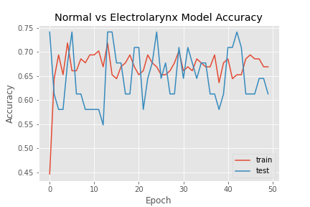
Results: Binary Classification Normal vs Electrolarynx
Training Accuracy | 69%
Testing Accuracy | 61%
Training Cross-Entropy | 0.59
Testing Cross-Entropy | 0.73
Notes:
https://machinelearningmastery.com/visualize-deep-learning-neural-network-model-keras/
Add in cross-entropy values

Slide 8
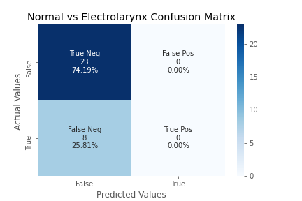
Results: Binary Classification Normal vs Electrolarynx
Example Ideal Confusion Matrix
True Neg
15
48.39%
False Pos
1
3.22%
False Neg
3
9.68%
True Pos
12
38.71%
Notes:
https://machinelearningmastery.com/visualize-deep-learning-neural-network-model-keras/
Edit the confusion matrix
Medhini put numbers on ideal
Add a slide on future steps and considerations

Slide 9
Summary and Future Work: Audio Pipeline
What we’ve accomplished: MFCCs might not be ideal as an audio feature for noisy data
Next step in the pipeline: Going back to audio videos to create dataset with singular words and record electrolarynx frequency
Future considerations:
Investigating other audio features: Melsprectrogram, Spectral Contrast, Wavelet transforms

Slide 10
VIDEO

Slide 11
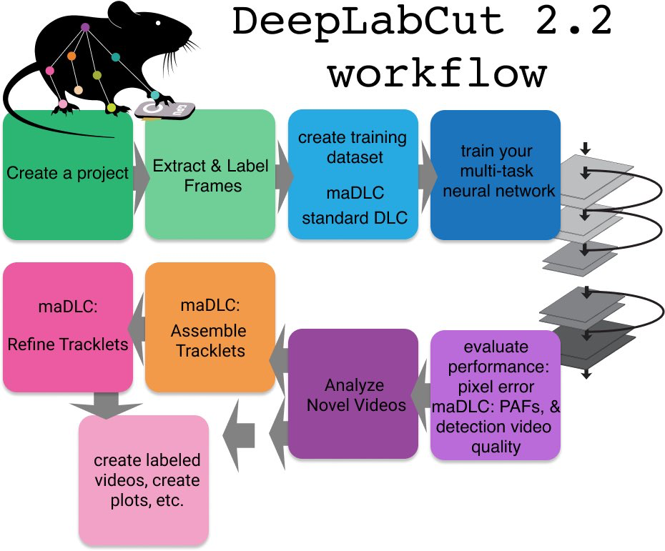
Materials and Methods: Video Pipeline
DeepLabCut uses a CNN to reduce data dimensionality from thousands of pixels to four lip points⁸
Each video was split into frames, which were clustered and labeled manually
The CNN was trained on 2500 labeled frames and tested on videos of conversational speech

Slide 12
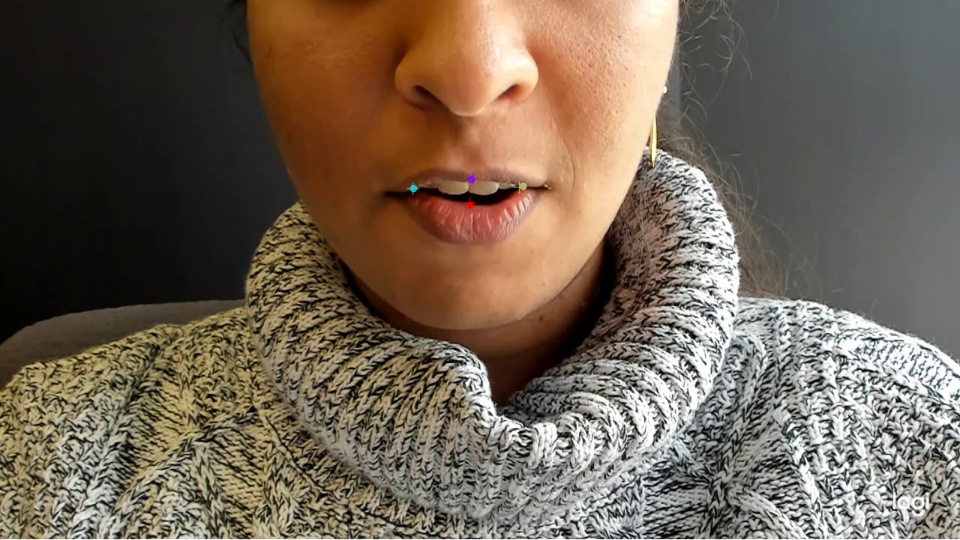
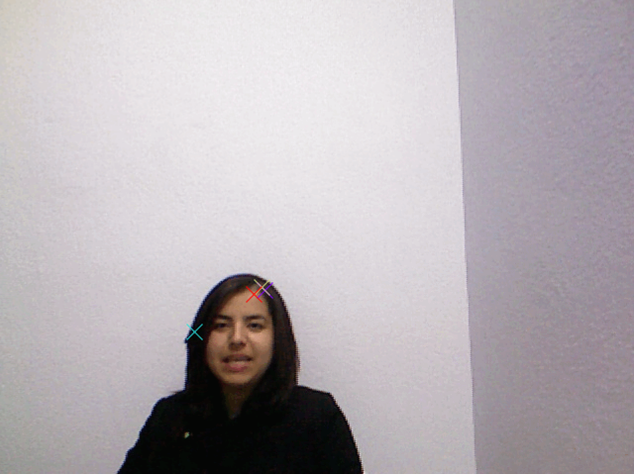
Results: Rainbow Passage Video Vs Open-Source Data Set
Rainbow Passage
Open-Source
 | Rainbow Passage | Open-Source Data Set
Training Error (Pixels) | 4.19 | 4.44
Testing Error (Pixels) | 5.22 | 134.65

Slide 13
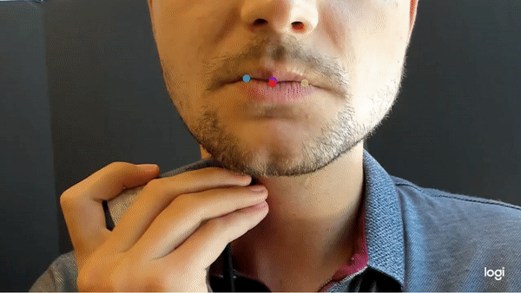
Results: Conversational Speech
Training Error | 3.8 Pixels
Testing Error | 5.11 Pixels
Notes:
Phonemes label then lstm
Make dots bigger (maybe put in video instead )--> ask TA too

Slide 14
Summary and Future Work: Video Pipeline
What we’ve accomplished: DeepLabCut can successfully predict points on a lip for similar distances from the camera
Next step in the pipeline: Labeling frames with the associated phoneme and use an LSTM to predict speech
Future considerations:
Shortening videos to facilitate the labeling process
Using videos with different speaker depths in training

Slide 15
Summary & Future Considerations
Summary
MFCCs might not be the most accurate to separate between electrolarynx and non-electrolarynx
Neural networks are able to predict the points around the mouth which can be associated with phonemes
Future Considerations
Use electrolarynx and non-electrolarynx videos with singular words
Increase diversity among videos (different ethnicities, distance from camera, etc.)
Development of new audio and video analysis techniques
Notes:
Medhini

Slide 16

Acknowledgements
Timothy Allen, PhD
Shannon Barker, PhD
Noah Perry
Vignesh Valaboju
James Daniero, M.D.
Haibo Dong, PhD
Rachel Jonas, M.D.
John Kelly
Jessica Lin
Holly Hess, SLP
Contact:
Surabhi Ghatti | sg2dk@virginia.edu
Medhini Rachamallu | mr3dn@virginia.edu
Katherine Taylor | kmt2ns@virginia.edu
Sameer Agrawal | sa9nc@virginia.edu
Notes:
Medhini
Also have to add in references

Slide 17
References
Kohlberg, G. D., Gal, Y. (Kobi) & Lalwani, A. K. Development of a Low-Cost, Noninvasive, Portable Visual
Speech Recognition Program. Ann Otol Rhinol Laryngol 125, 752–757 (2016).
Rameau, A. Pilot study for a novel and personalized voice restoration device for patients with laryngectomy.
Head & Neck 42, 839–845 (2020).
Patak, L. et al. Communication boards in critical care: patients’ views. Applied Nursing Research 19, 182–190
(2006).
Rehabilitation following total laryngectomy: Oncologic, functional, socio-occupational and psychological
aspects - ClinicalKey. https://www.clinicalkey.com/#!/content/playContent/1-s2.0-
S1879729620301459?returnurl=https:%2F%2Flinkinghub.elsevier.com%2Fretrieve%2Fpii%2FS187972962030
1459%3Fshowall%3Dtrue&referrer=https:%2F%2Fpubmed.ncbi.nlm.nih.gov%2F.
Wulff, N. B., Højager, A., Wessel, I., Dalton, S. O. & Homøe, P. Health-Related Quality of Life Following Total
Laryngectomy: A Systematic Review. The Laryngoscope 131, 820–831 (2021).
Oozeer, N. B. et al. Functional status after total laryngectomy: cross-sectional survey of 79 laryngectomees
using the Performance Status Scale for Head and Neck Cancer. The Journal of Laryngology & Otology 124,
412–416 (2010).
Lenain, R., Weston, J., Shivkumar, A. & Fristed, E. Surfboard: Audio Feature Extraction for Modern Machine Learning. in Interspeech 2020 2917–2921 (ISCA, 2020). doi:10.21437/Interspeech.2020-2879.
Nath, T. et al. Using DeepLabCut for 3D markerless pose estimation across species and behaviors. Nat Protoc
14, 2152–2176 (2019).
Notes:
Medhini

Slide 18
Additional Resources

Slide 19
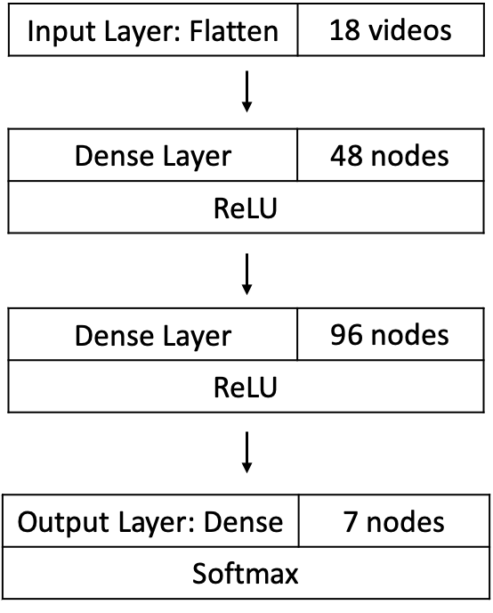
Materials and Methods: Audio Pipeline
Multiple Iterations with trial and error
Butterworth filter construction python scipy
MFCCs (Mel Frequency Cepstral Coefficients) with surfboard
Binary classification (Normal vs Electrolarynx) with DNN with keras
Multi-label classification with Audacity clipped videos to put in a DNN with keras
Labels: When, the, sunlight, strikes, raindrops, in, air
Notes:
Add in activation functions
Delete slide

Slide 20
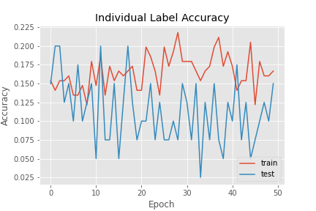
Results: Multi-Label Classification
Training Accuracy | 17%
Testing Accuracy | 15%
Training Cross-Entropy | 2.33
Testing Cross-Entropy | 2.48
Notes:
https://machinelearningmastery.com/visualize-deep-learning-neural-network-model-keras/
Medhini → maybe just focus on binary (main focus)
delete

Slide 21
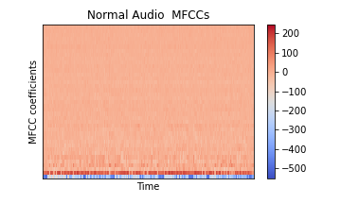
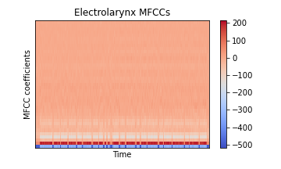
Results: MFCC Coefficients
Notes:
https://machinelearningmastery.com/visualize-deep-learning-neural-network-model-keras/
Medhini → maybe just focus on binary (main focus)
delete

